Slide 1
MS-606
ATTITUDES AND JOB SATISFACTION

Slide 2
Attitudes
Attitudes are evaluative statements-either favorable or unfavorable-about objects, people, or events.
They reflect how we feel about something.
“I like my job”

Slide 3
Main Components of Attitudes
Cognitive component of an attitude-a description of or belief in the way things are.
The statement “My pay is low”
Affect is the emotional or feeling segment of an attitude
“I am angry over how little I’m paid.”
The behavioral component of an attitude describes an intention to behave in a certain way toward someone or something
“I’m going to look for another job that pays better.”

Slide 4
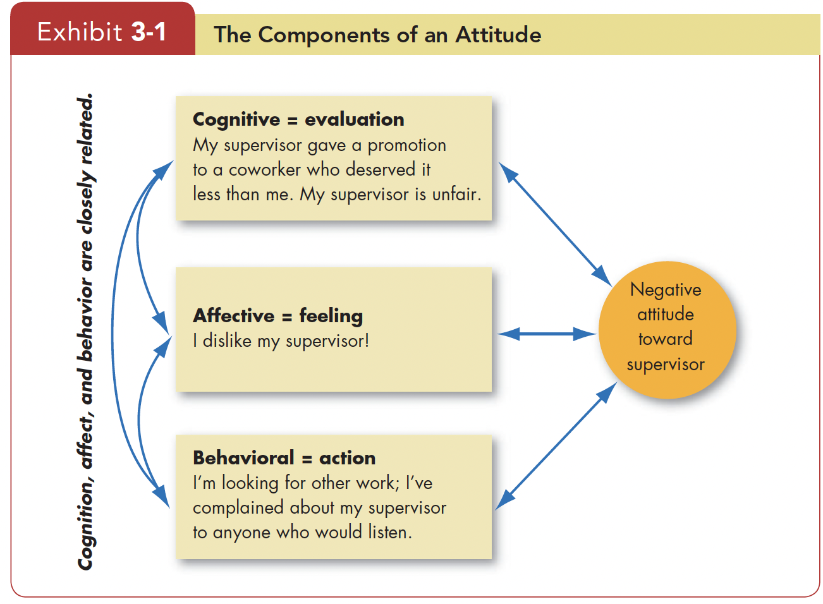

Slide 5
Does Behavior Always Follow from Attitudes?
Early research on attitudes assumed they were causally related to behavior.
In the late 1960s, Leon Festinger argued that attitudes follow behavior.
Cognitive dissonance - any incompatibility an individual might perceive between two attitudes or between behavior and attitudes.
Any form of inconsistency is uncomfortable and that individuals will therefore attempt to reduce it.
People either alter the attitudes or the behavior, or they develop a rationalization for the discrepancy.
Rewards of dissonance

Slide 6
Major Job Attitudes
Job satisfaction A positive feeling about one’s job resulting from an evaluation of its characteristics.
Job involvement the degree to which people identify psychologically with their job and consider their perceived performance level important to self-worth.
Psychological empowerment Employees’ belief in the degree to which they affect their work environment, their competence, the meaningfulness of their job, and their perceived autonomy
Organizational commitment The degree to which an employee identifies with a particular organization and its goals and wishes to remain a member
Perceived organizational support (POS) The degree to which employees believe an organization values their contribution and cares about their well-being.
Employee engagement An individual’s involvement with, satisfaction with, and enthusiasm for the work he or she does.

Slide 7
Measuring Job Satisfaction
A positive feeling about a job resulting from an evaluation of its characteristics
The first approach, the single global rating is a response to one question, such as “All things considered, how satisfied are you with your job?” Respondents circle a number between 1 and 5 on a scale from “highly satisfied” to “highly dissatisfied.”
The second method identifies key elements in a job such as the nature of the work, supervision, present pay, promotion opportunities, and relationships with co-workers. Respondents rate these on a standardized scale, and researchers add the ratings to create an overall job satisfaction score.
Is one of these approaches superior?

Slide 8
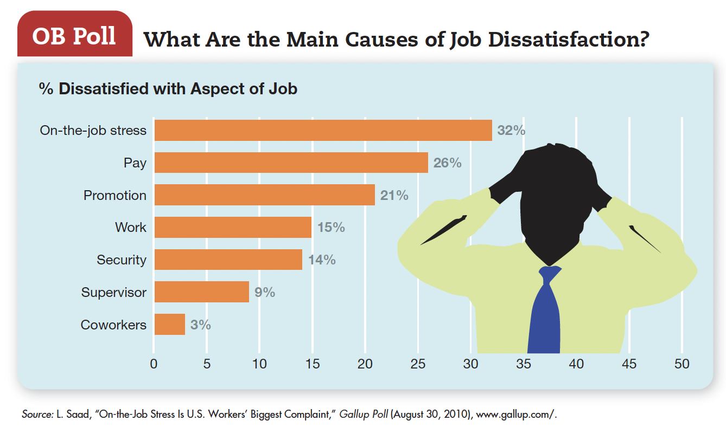

Slide 9
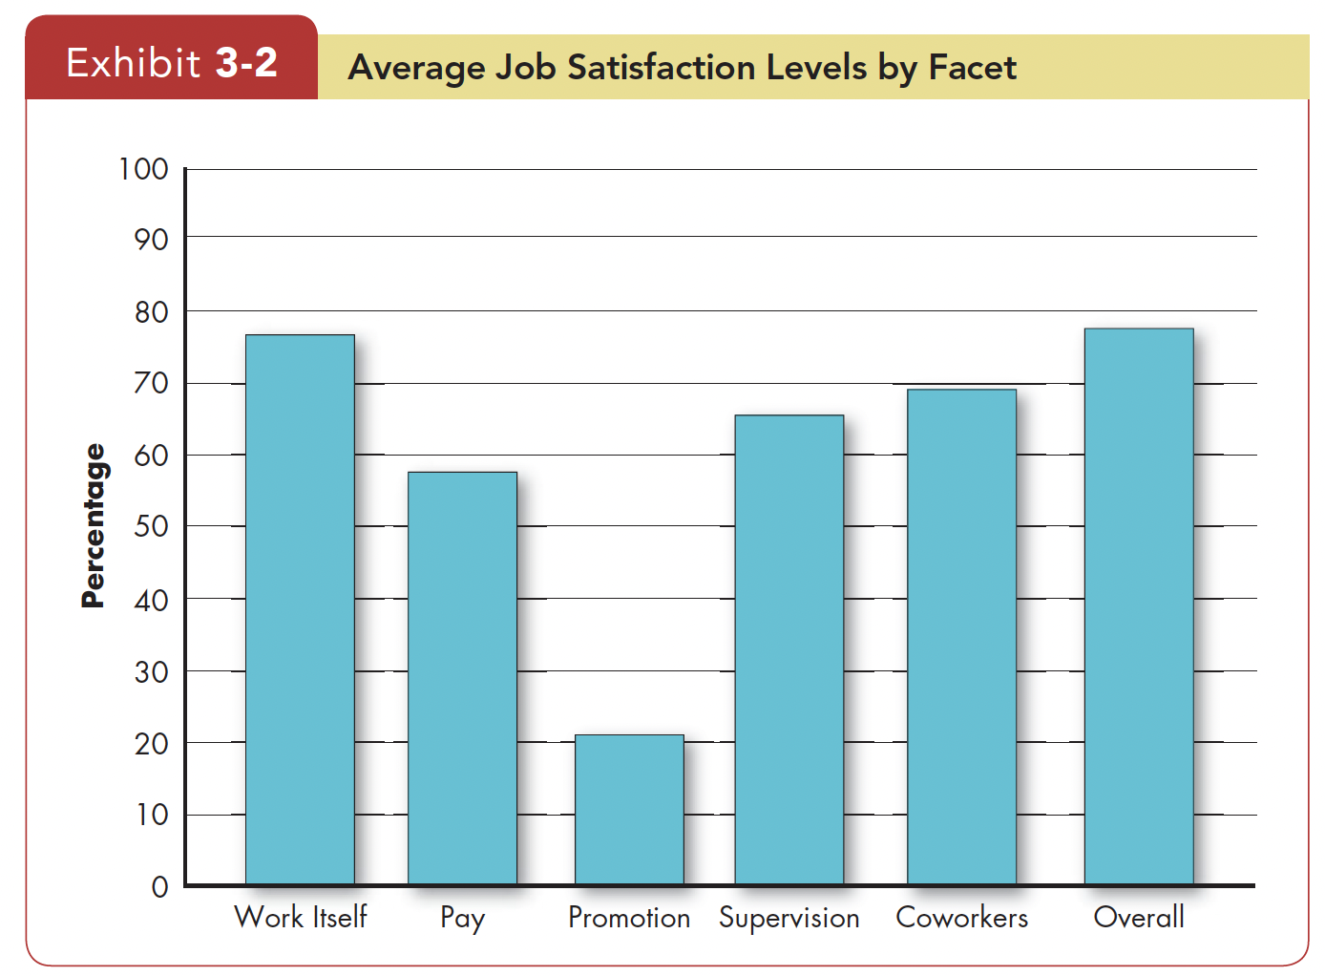

Slide 10
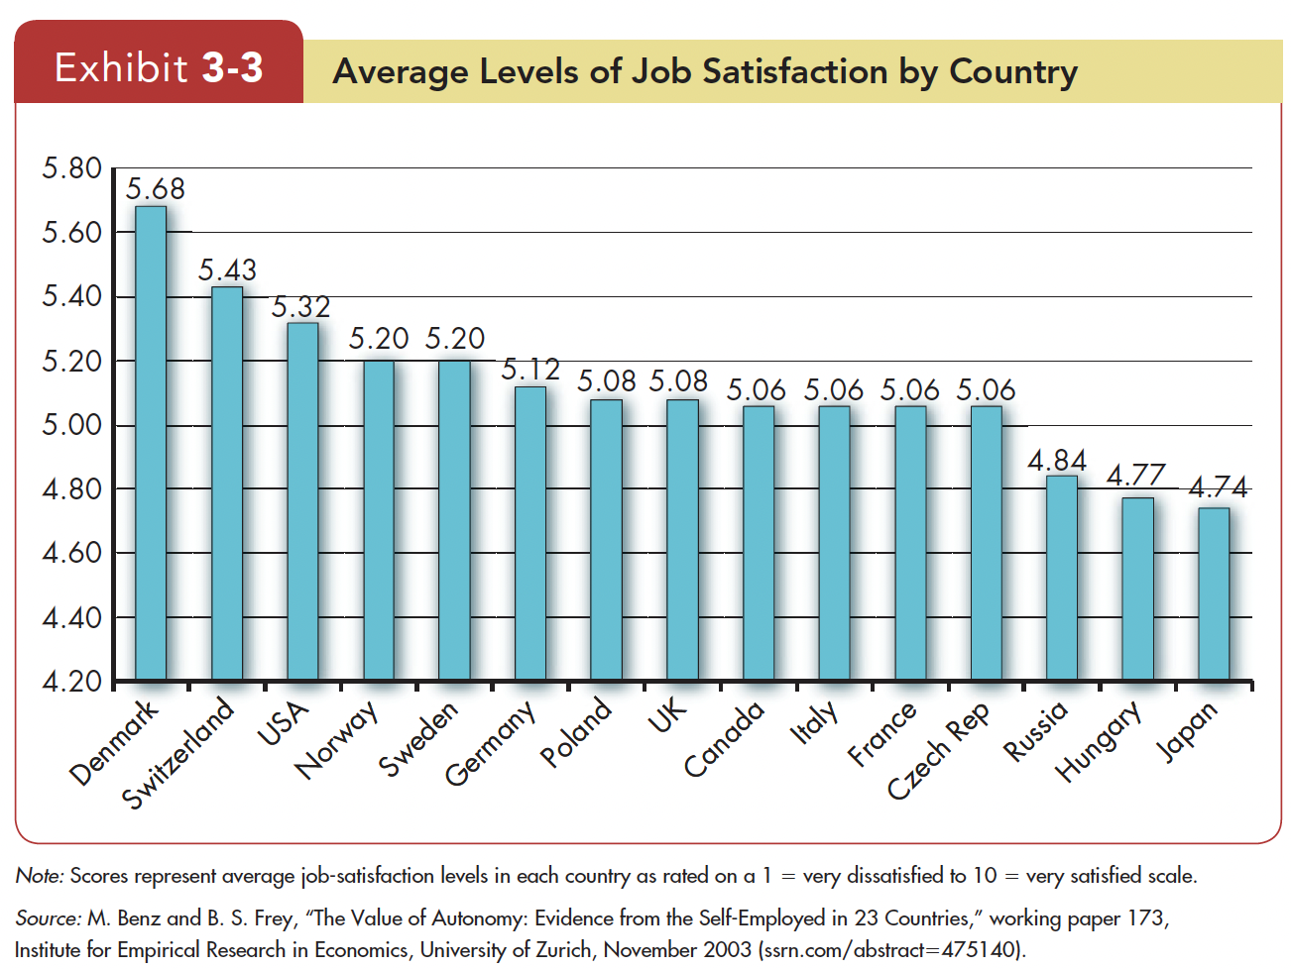

Slide 11
Causes of Job Satisfaction
Interesting jobs that provide training, variety, independence, and control satisfy most employees
Interdependence, feedback, social support, and interaction with co-workers outside the workplace are strongly related to job satisfaction
Pay motivate people. But what motivates us is not necessarily the same as what makes us happy.
People who have positive core self-evaluations –who believe in their inner worth and basic competence-are more satisfied with their jobs than those with negative core self-evaluations.

Slide 12
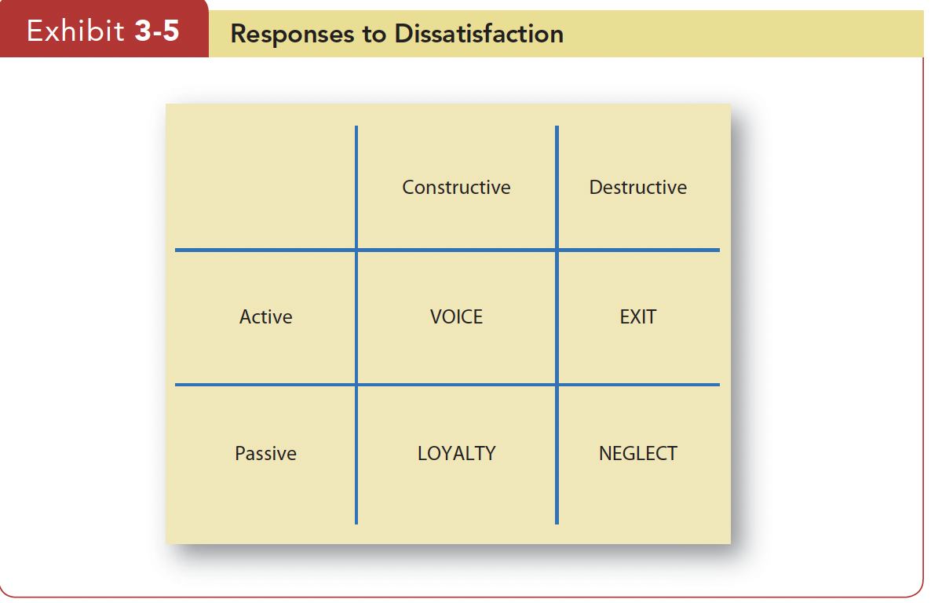
Employee responses to dissatisfaction
Exit Dissatisfaction expressed through behavior directed toward leaving the organization
Voice Dissatisfaction expressed through active and constructive attempts to improve conditions
Loyalty Dissatisfaction expressed by passively waiting for conditions to improve.
Neglect Dissatisfaction expressed through allowing conditions to worsen.
Union members often express dissatisfaction through the grievance procedure or formal contract negotiations.

Slide 13
Favorable Job Attitudes Make Organizations More Profitable

Slide 14
Virtuous cycle: having satisfied employees tends to improve subsequent financial performance, which tends to improve later employee satisfaction even further.

Slide 15
Job Satisfaction
Job Satisfaction and Job Performance: Strong support for the satisfaction–performance relationship
Job Satisfaction and Organizational Citizenship Behavior (OCB): Satisfied employees would seem more likely to talk positively about the organization, help others, and go beyond the normal expectations in their job because they want to reciprocate their positive experiences.

Slide 16
Job Satisfaction
Job Satisfaction and Customer Satisfaction: For frontline employees who have regular customer contact, Satisfied employees increase customer satisfaction and loyalty
Job Satisfaction and Absenteeism: Consistent negative relationship between satisfaction and absenteeism.
But, other factors affect the relationship. Organizations that provide liberal sick leave benefits encourage even satisfied employees. When numerous alternative jobs are available, dissatisfied employees have high absence rates, but when there are few they have the same (low) rate.

Slide 17
Job Satisfaction
Job Satisfaction and Turnover: The satisfaction–turnover relationship also is affected by alternative job prospects.
If an employee is presented with an unsolicited job offer, job dissatisfaction is less predictive of turnover
Similarly, job dissatisfaction is more likely to translate into turnover when employment opportunities are plentiful
When employees have high “human capital” (high education, high ability), job dissatisfaction is more likely to translate into turnover

Slide 18
Job Satisfaction
Job Satisfaction and Workplace Deviance: Job dissatisfaction and antagonistic relationships with co-workers predict a variety of behaviors organizations find undesirable, including unionization attempts, substance abuse, stealing at work, undue socializing, and tardiness.
Researchers argue these behaviors are indicators of a broader syndrome called deviant behavior in the workplace (or counterproductive behavior or employee withdrawal ).

Slide 19
When Managers "Don't Get It": The Perception Gap
Many managers are unconcerned about employee job satisfaction. Still others overestimate how satisfied employees are with their jobs, so they don’t think there’s a problem when there is.
Regular surveys can reduce gaps between what managers think employees feel and what they really feel.
Jonathan McDaniel, manager of a KFC restaurant in Houston, surveys his employees every 3 months.

Slide 20

Employer-Employee Loyalty is an Outdated Concept

Slide 21
Employer-Employee Loyalty
Point: Workplace guru Linda Gratton says, “Loyalty is dead-killed off through shortening contracts, outsourcing, automation and multiple careers
Employers tend to cut commitments to an employee, and reduce his or her benefits, if they perceive they can do so.
Employees tend to jump at the best available job offer as soon as they see it.

Slide 22
Employer-Employee Loyalty
Counterpoint: Says management guru Tom Peters, “Bottom line: loyalty matters. A lot. Yesterday. Today. Tomorrow.”
“Leaders who encourage loyalty want employees who are not only committed to and engaged in their work but who also find meaning from it.”
Says workplace psychologist Binna Kandola, “Workplaces may have changed but loyalty is not dead-the bonds between people are too strong.”

